Slide 1
Big Data, Predictive Analytics, and Security
ITEA Annual Symposium
4 October 2016
Reston, VA
Mark J. Kiemele, Ph.D.
President and Co-Founder
Air Academy Associates
Office: 719-531-0777
Cell: 719-337-0357
mkiemele@airacad.com
www.airacad.com
16-BIGPASEC-10A
Notes:
0

Slide 2
Goals
What is Big Data?
Why is it so popular?
Big Data and Predictive Analytics
Its relationship to Security Intelligence
Securing Big Data
Analyzing Big Data
Resources Needed

Slide 3
A Definition of Big Data
Volume
This is the most common definition associated with Big Data.
1 Bit = Binary Digit 8 Bits = 1 Byte 1000 Bytes = 1 Kilobyte 1000 Kilobytes = 1 Megabyte 1000 Megabytes = 1 Gigabyte 1000 Gigabytes = 1 Terabyte 1000 Terabytes = 1 Petabyte 1000 Petabytes = 1 Exabyte 1000 Exabytes = 1 Zettabyte 1000 Zettabytes = 1 Yottabyte 1000 Yottabytes = 1 Brontobyte 1000 Brontobytes = 1 Geopbyte
Big Data is about the storage and analysis of large sets of data.

Slide 4
A Definition of Big Data
Velocity
Data streams in at unprecedented speeds and must be dealt with in a timely manner.
RFID tags, sensors, and smart metering are driving the need to deal with huge amounts of data in near-real time.
Currently available Big Data technologies deal with huge sets of data at rest in batch-oriented jobs - run a query, analyze results, tweak query, analyze again, and repeat.
This is not the streaming scenario in which a constantly updated tactical situation is analyzed.
Future systems need to handle real-time analytics, especially in security scenarios.

Slide 5
A Definition of Big Data
Variety
Data comes in all types of formats
structured, numeric data in traditional databases with nice rows and columns, namely relational databases like SQL
unstructured text documents in multiple languages
email, video, audio, tweets
stock ticker data, financial transactions

Slide 6
Industry (3V) Definition of Big Data* (*source: Doug Laney)
Volume
Big
Data
Velocity
Variety

Slide 7
4V Definition of Big Data
Volume
Veracity
Veracity
Big
Data
Velocity
Variety

Slide 8
Simple Definition
We have “Big” data when the volume/velocity/variety/veracity of the data becomes part of the problem we are trying to solve.

Slide 9
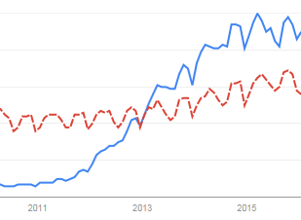
The Popularity of Big Data from Google Trends
Big Data
Data Analysis

Slide 10
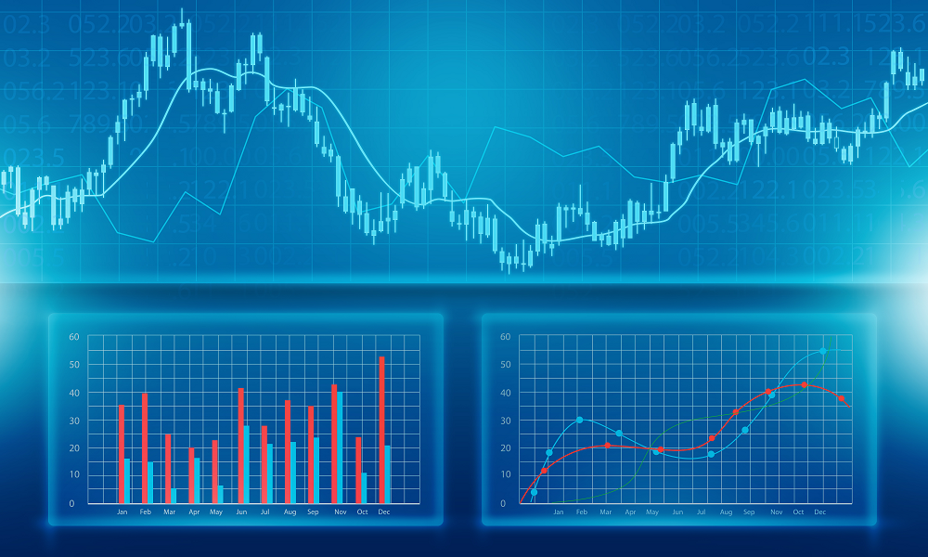
Predictive Analytics
“It’s tough to make predictions –
especially about the future.”
Yogi Berra

Slide 11
Big Data + Predictive Analytics = Value
Big Data
Predictive
Analytics
Better, Faster
Decision Making
Knowledge
Value:
Vision
Decision
Precision
Domain Expertise
Predictive
Analytic
Tools
Notes:
9
PURPOSE OF THIS SLIDE: Define over-production and describe why it is wasteful.
KEY POINTS:
- What is over production? Simply building or constructing more than the requirements called for “just in case” there’s a problem.
- This mentality argues the extra effort is worthwhile because you can immediately replace a defective item.
Overproduction is purely reactive. It bases work output on past experience without “drilling” down to the root cause.
- Over production wastes time, manpower, money and inventory. It can consume valuable parts and create more work if and when the decision is made to “tear” the excess product back down.
- Action Workout allows us to drill down to the root cause and examine the real reasons why we’re over-producing.
Examples of over production: Building excessive cargo palettes because they’re pre-planning that some of the palettes will be defective, processing more passengers for a deployment so there are replacements if some people are found unfit to deploy.
NOTE TO THE INSTRUCTOR: Ask the class if they have some additional examples of this concept that they’ve witnessed in their work center that they can share with the rest of the class.
TRANSITION: While you may believe that over production helps you respond to your customer need, the defective product you provided the first time may require him/her to fall prey to the next type of waste.
(MP 3) List the seven types of waste

Slide 12
Industries Where Predictive Models are Used (Source: Predictive Analytics by Eric Siegel)
Marketing, Advertising, and the Web
Family and Personal Life
Financial Risk and Insurance
Healthcare, Medical, Pharmaceutical
Crime Fighting and Fraud Detection
Fault Detection for Safety and Efficiency
Government, Politics, Nonprofit, and Education
Human Language Understanding, Thought, and Psychology
Staff and Employees – Human Resources
Defense
Engineering
Oil, Gas, Energy

Slide 13
Examples of What is Being Predicted (Source: Predictive Analytics by Eric Siegel)
Likelihood of elderly dying within the next 18 months
Target predicts customer pregnancy from shopping behavior
Love (Match.com predicts interest in communicating)
Breast cancer; premature births and other health related metrics
Fraudulent tax returns, insurance and warranty claims
Terrorist attacks
Online activities that are malicious intrusions and attacks vs. legitimate activities
Nuclear reactor failures (e.g., cracks in cooling pipes)
Which voters are positively influenced by what type of contact and which voters will be affected adversely by contact
Electricity demand growth to direct infrastructure development
Lying and deception via eye movement and written statements
Employee churn, job performance, and student dropouts

Slide 14
Cautions Concerning Big Data
The myth that more data is always better.
The myth that big data makes up for the lack of quality in the data.
The low cost of data storage allows us to stash away troves of data, not knowing if we will ever need it or use it.
There is much more noise in Big Data, making it more difficult to separate the true signal from the noise.
Big Data contains all kinds of spurious correlations.
While correlation may help us predict, correlation does not mean causality.

Slide 15
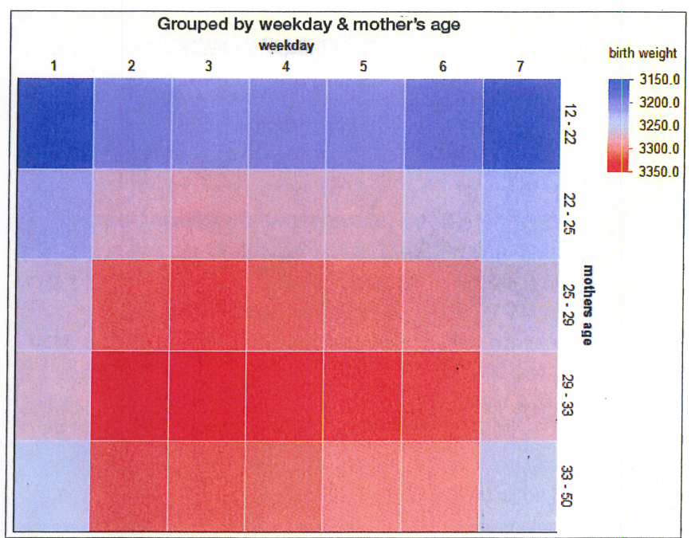
Relationship Between 3 Variables (from more than 12 million records – these are average weights)

Slide 16
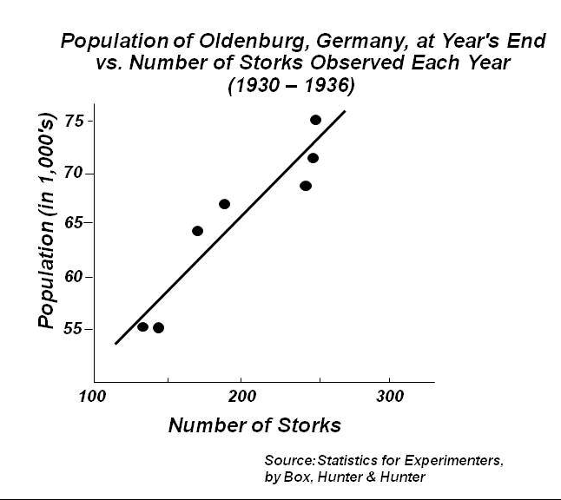
Correlation vs Causality

Slide 17
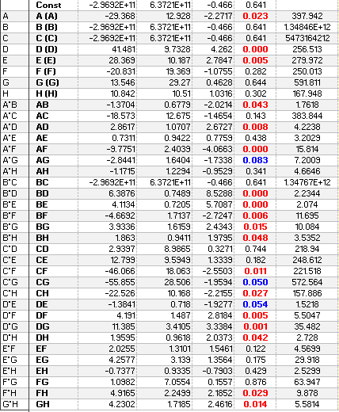
Regression Analysis (helps separate the signal from the noise)

Slide 18
Big Data and the Security Issue
Securing the data itself
Using Big Data Analytics to predict and prevent security incidents

Slide 19
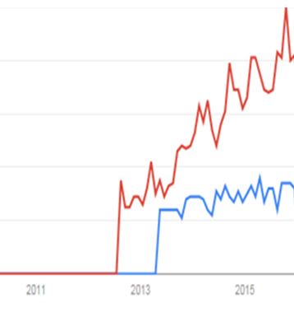
Google Trends
Big Data Analysis
Big Data Security

Slide 20
Big Data and the Security Issue
Securing the data itself
Data security must be designed into the system.
Few organizations are likely to build a Big Data environment in-house.
Most will use the cloud to store the data.
Encryption and access controls can help.
From Arthur Coviello, EVP for EMC’s RSA Security Division:
“With the pervasiveness of big data touching everything we do, our attack surface is about to be altered and expanded, and our risks magnified in ways we couldn’t have imagined.”

Slide 21
Big Data and the Security Intelligence Challenge
Using Big Data Analytics to predict and prevent security incidents
Big Data expands the boundaries of existing information security responsibilities and introduces significant new risks and challenges.
Big Data silos prevent complete analysis.
Cybersecurity scenarios require analysis of massive amounts of data as it’s produced, with conclusions reached within seconds.
New algorithms are needed.
Must integrate the sciences of statistics, mathematics, and computer science – this is often called Data Science.

Slide 22
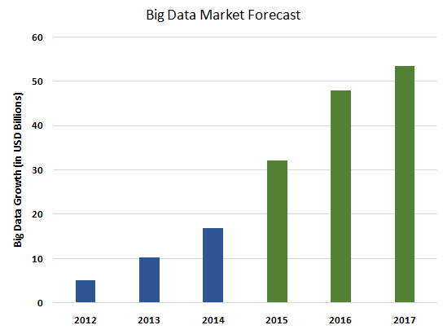
Forecasting Big Data’s Spending

Slide 23
The Big Data Analytics Skills Shortage
According to McKinsey Global Institute, there will be more than a 200,000 job shortage in data science by 2018.
Data science is a multi-disciplinary activity involving statistics, applied mathematics, computer science, engineering, economics, and other related fields.
Doing predictive analytics today is best done by a team.
Our university system, in spite of its recent increased emphasis via degree programs on data analytics, cannot keep up with the demand for data scientists.
Data Analytics applies to small data as well as big data.
If one cannot do analysis on small data, it is highly likely he won’t be able to handle big data either.
According to Nate Silver, from the FiveThirtyEight blog and grand prognosticator of the 2008 and 2012 presidential elections, “I think data scientist is a sexed-up term for a statistician.”

Slide 24
Some Final Thoughts
There has been plenty of hype on the subject of Big Data.
When it comes to security intelligence, we are going to need Big Data.
For the ability to analyze data in near or real time for the purpose of predicting and preventing cyber attacks; fraud, waste, and abuse; and terrorist attacks, just to name a few.
And thus there is the need for getting good data, including the right data, as well as protecting and securing it.
There is a shortage of properly trained resources to handle big data analytics.
We need an increased emphasis on developing those resources, as better technology and prediction algorithms than what we have today are needed.

Slide 25
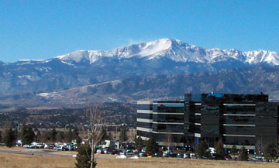
Questions
Thank You
Colorado Springs, Colorado
Notes:
24

Slide 26
For More Information, Please Contact
Air Academy Associates, LLC 1650 Telstar Drive, Ste 110 Colorado Springs, CO 80920
Toll Free: (800) 748-1277 or (719) 531-0777 Facsimile: (719) 531-0778 Email: aaa@airacad.com Website: www.airacad.com

